Slide 1
ACI Webinar #3 MinMax Algorithm and Logic using Prolog
WILP Division, BITS-Pilani

Slide 2
Minimax Algorithm in AI (Game Theory)
The Minimax algorithm is a decision-making algorithm used in two-player turn-based games like Chess, Tic-Tac-Toe, and Checkers. It helps in finding the best move by assuming that:
One player (Maximizer) tries to maximize the score (best outcome).
The opponent (Minimizer) tries to minimize the score (worst outcome for Maximizer).

Slide 3
How Minimax Works
1. Game Tree Construction
The game state is represented as a tree, where:
Root node represents the current state.
Branches represent possible moves.
Leaf nodes represent terminal states (win, lose, or draw).

Slide 4
How Minimax Works
2. Assigning Scores (Utility Values)
At the leaf nodes:
Win → +10 (Maximizer's favor)
Loss → -10 (Minimizer's favor)
Draw → 0 (Neutral outcome)

Slide 5
How Minimax Works
3. Backpropagation Using Minimax
Moving up the tree, each parent node is assigned:
Max value if it’s a Maximizer’s turn.
Min value if it’s a Minimizer’s turn.
4. Choosing the Best Move
The root node selects the move with the highest score for Maximizer.

Slide 6
Drawback of minimax
Minimax can be slow due to its exponential complexity (O(b^d)), where:
b = Branching factor (number of moves per turn).
d = Depth of the game tree.

Slide 7
Alpha-Beta Pruning
Alpha-Beta Pruning improves efficiency by eliminating unnecessary branches:
Alpha (α) → Best score Maximizer can get.
Beta (β) → Best score Minimizer can get.
If α ≥ β, further evaluation of a branch is pruned (skipped).

Slide 8
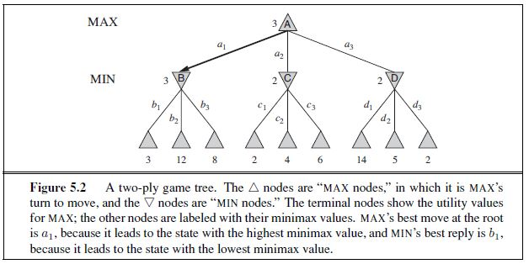
Min Max algorithm

Slide 9
Alpha Beta pruning
α = the value of the best (i.e., highest-value) choice we have found so far at any choice point along the path for MAX.
β = the value of the best (i.e., lowest-value) choice we have found so far at any choice point along the path for MIN.
Alpha–beta search updates the values of α and β as it goes along and prunes the remaining branches at a node (i.e., terminates the recursive call) as soon as the value of the current node is known to be worse than the current α or β value for MAX or MIN, respectively

Slide 10
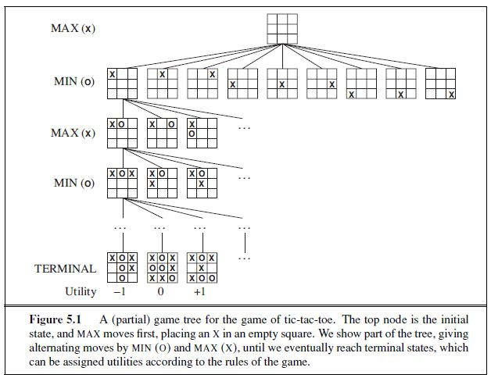
The problem –Tic Tac Toe game

Slide 11
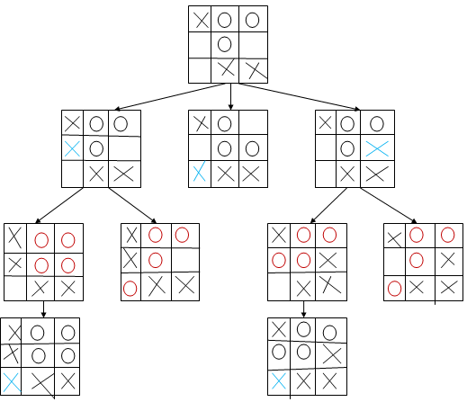
Tic Tac Toe game

Slide 12
Code Walk through in PYTHON - TicTacToe
Parameters (what each one means)board:
current game state (3×3 grid with "X", "O", or "").
depth: recursion depth (root = 0).
alpha: best value MAX (X) can guarantee so far along the current path (starts at −∞).
beta: best value MIN (O) can force so far along the current path (starts at +∞).
is_maximizing: True for X’s turn (MAX), False for O’s turn (MIN).

Slide 13
#Class TicTacToe
Draw the Board
Determines if the made move is a legal move
Checks if the game has ended and returns the winner in each case - #is_endofgame() function
Check for win over the Row wise, Column wise, Diagonal wise or Is whole board full? (Draw)
minimax_ab(board, depth, alpha, beta, is_maximizing) Implements Minimax search enhanced with Alpha–Beta pruning, recursive AI logic.
best_move_ab(board, is_maximizing) Chooses best move for current player, measures performance.
Print Stats
Calling the game

Slide 14
#Max player
We try every legal move for X.
For each move: Make the move on the board.
Recurse to evaluate it assuming MIN moves next.
Undo the move (backtrack).
Update max_eval with the best score seen so far.
Update alpha because we’ve improved MAX’s guaranteed value.
Pruning condition: if beta <= alpha, MIN already has a response elsewhere that’s no worse (for MIN) than what we’re exploring now, so searching further down this branch won’t change the final decision. We increment stats["pruned"] and cut this branch immediately.

Slide 15
#Max player
if is_maximizing:
max_eval = -math.inf
for i in range(3):
for j in range(3):
if board[i][j] == "":
board[i][j] = "X"
eval_val = minimax_ab(board, depth + 1, alpha, beta, False)
board[i][j] = ""
max_eval = max(max_eval, eval_val)
alpha = max(alpha, eval_val)
if beta <= alpha:
stats["pruned"] += 1
return max_eval
return max_eval

Slide 16
#Min player
Symmetric to MAX but minimizing:
min_eval tracks the worst (lowest) outcome for MAX, which is best for MIN.
beta is updated to reflect MIN’s best defensive bound.
Pruning again at beta <= alpha:MAX already has a path ensuring at least alpha.
If MIN can hold us to beta where beta ≤ alpha, MAX won’t choose this branch anyway → stop.

Slide 17
#Min player
else:
min_eval = math.inf
for i in range(3):
for j in range(3):
if board[i][j] == "":
board[i][j] = "O"
eval_val = minimax_ab(board, depth + 1, alpha, beta, True)
board[i][j] = ""
min_eval = min(min_eval, eval_val)
beta = min(beta, eval_val)
if beta <= alpha:
stats["pruned"] += 1
return min_eval
return min_eval

Slide 18
#Summary tic tac toe
Minimax Algorithm → explores all possible game outcomes
Alpha–Beta Pruning → skips unnecessary branches to improve speed
alpha tracks the best guaranteed outcome for MAX so far on the path.
beta tracks the best guaranteed outcome for MIN so far on the path.
When beta ≤ alpha, the current branch cannot affect the ancestor’s decision → stop exploring that branch.
Improvements - Move ordering matters: trying stronger moves first (center, corners) often triggers earlier pruning → faster.
You could add a depth penalty in evaluate (e.g., score - depth for wins, score + depth for losses) to prefer faster wins / slower losses.

Slide 19
#Summary tic tac toe
Component | Description
Game Logic | Functions for board display, winner check, move availability, and evaluation scoring.
Minimax Function | Recursively simulates all future moves to find the optimal outcome.
Alpha–Beta Pruning | Uses α (best for MAX) and β (best for MIN) to cut off subtrees that can’t improve results.
Best Move Function | Iterates over all possible moves → calls Minimax → chooses best one.
Auto-Play Mode | Both X and O are controlled by AI for comparison and performance analysis.
Metrics | Counts nodes explored, branches pruned, max depth, and execution time.

Slide 20
DEMO
DEMO

Slide 21

Prolog Programming
What is Prolog ?
Prolog (programming in logic) is a logic-based programming language: programs correspond to sets of logical formulas and the Prolog interpreter uses logical methods to resolve queries.
Prolog is a declarative language: you specify what problem you want to solve rather than how to solve it.
Prolog is very useful in some problem areas, such as AI, NLP, databases, but pretty useless in others, such as for instances graphics or numerical algorithms.
The objective of this webinar is to introduce you to implementing Prolog.
https://www.swi-prolog.org/

Slide 22
Prolog Programming
What is Prolog ?
It's declarative: very different from imperative style programming like Java, C++, Python,..
A program is partly like a database but much more powerful since we can also have general rules to infer new facts!
A Prolog interpreter can follow these facts/rules and answer queries by sophisticated search.
Prolog is mainly suitable for programs involve symbolic or non-numeric computations.
The following are very useful for writing a program in Prolog:
1. Knowledge Base, 2. Facts, 3. Rules, and 4. Queries.

Slide 23
Facts
A Fact represents an unconditionally true statement in Prolog (written in lowercase)
Defines explicit relationships between objects and properties.
Facts form the base-level information in Prolog.
Facts store knowledge without conditions.
Prolog retrieves them as-is.
Examples
% Facts: Defining Relationships
fruit(orange)
parent(john, mary).
likes(john, orange)

Slide 24
Rules
A Rule defines a conditional relationship between objects.
Rules help Prolog infer new information based on existing facts.
Rules connect multiple facts to form logical reasoning. Rules generalize knowledge dynamically. Prolog derives conclusions by chaining facts together.
Rules in Prolog define new relationships based on existing facts. A rule consists of:
A head (the conclusion).
A body (the conditions that must be met).
A :- (which means "if", similar to implication in logic).
rule_name(Variable1, Variable2) :- condition1, condition2, ..., conditionN.
"Variable1 and Variable2 satisfy rule_name if all conditions on the right side are true.“
[happy(john) :- drives(john, car).]

Slide 25
Queries
Queries retrieve knowledge from the Knowledge Base.
Queries match against facts and rules to get logical answers.
They return true/false or list all valid answers.
% Facts
parent(john, mary).
parent(mary, susan).
parent(david, john).
% Queries
?- parent(X, mary). % Who is Mary's parent?
?- parent(mary, X). % Who are Mary's children?
?- parent(_, john). % Is there any parent of John?

Slide 26
Knowledge Base
A collection of facts and rules that describe relationships.
It serves as a logical database used for inference.)
% Facts
weather(sunny).
weather(rainy).
% Rules
recommend_clothing(tshirt) :- weather(sunny).
recommend_clothing(umbrella) :- weather(rainy).
% Query
?- recommend_clothing(What).

Slide 27
Knowledge Base, Facts, Rules and Queries
The Prolog Knowledge Representation System
Component | Definition | Example
Facts | Statements that are always true | fruit(orange).
Rules | Conditional relationships based on logic | happy(john) :- drives(john, car).
Queries | Questions that retrieve information from the Knowledge Base | ?- happy(john).
Knowledge Base | A collection of facts and rules | fruit(apple). fruit(banana).

Slide 28
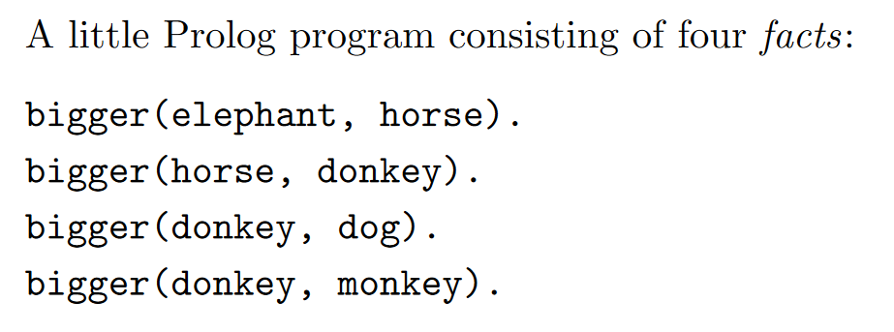
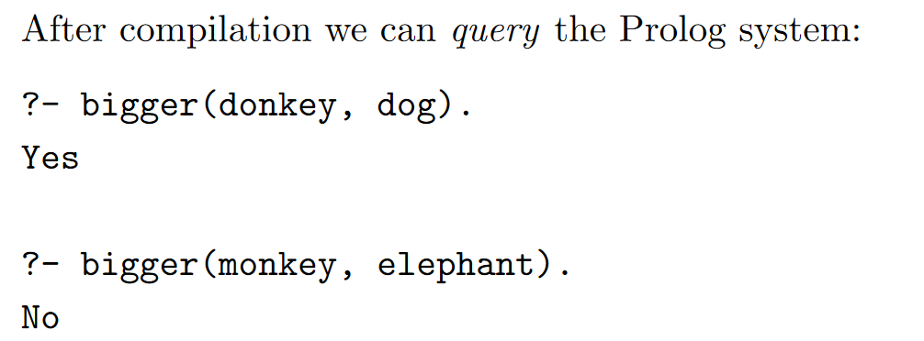
Facts & Queries

Slide 29
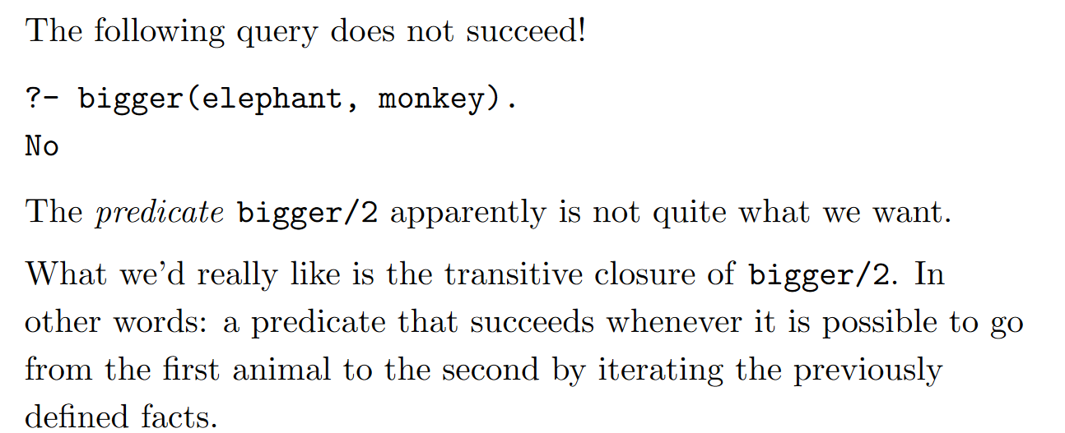
Issue?
How to solve this ? Rules

Slide 30
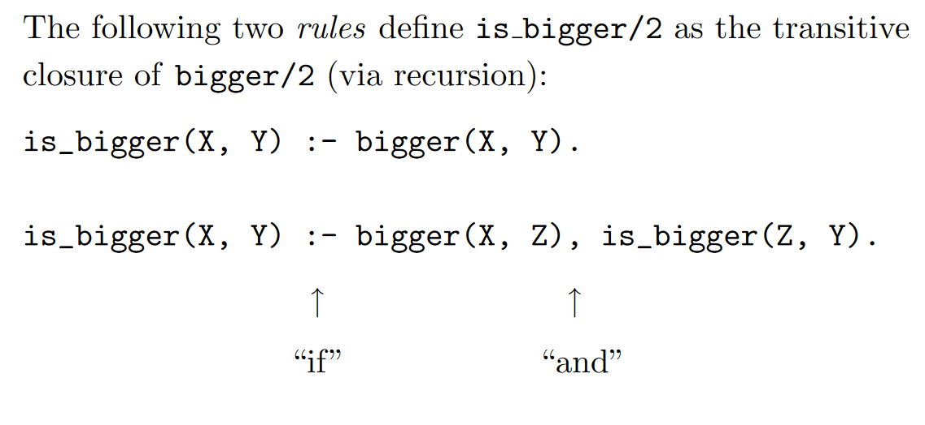
Rules

Slide 31
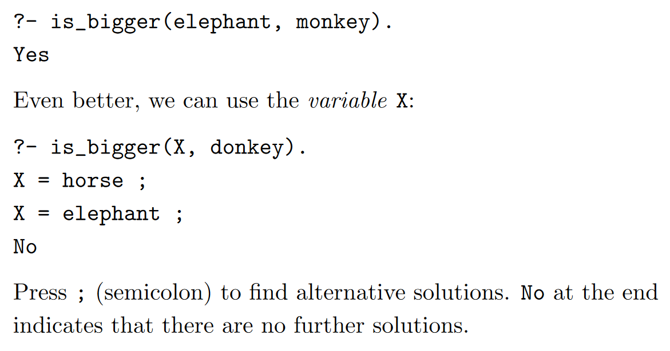
Rules

Slide 32
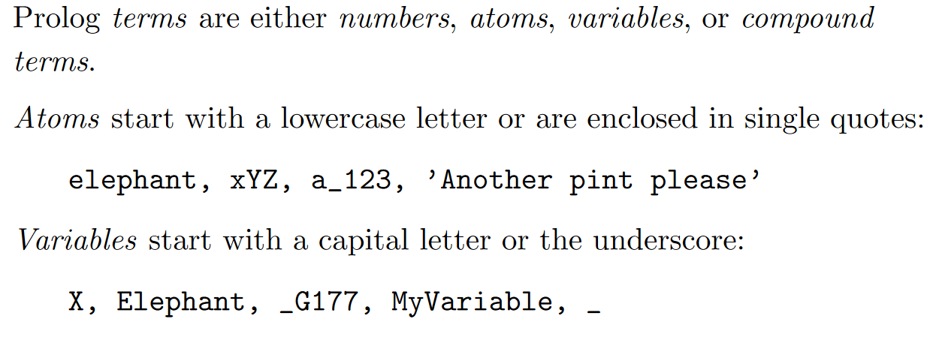
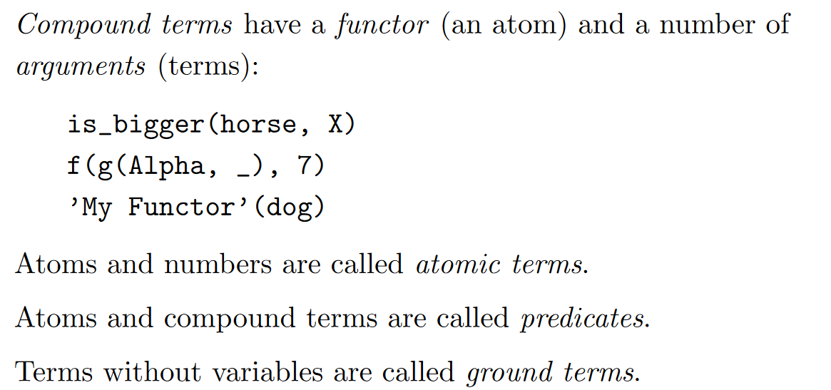
Terms

Slide 33
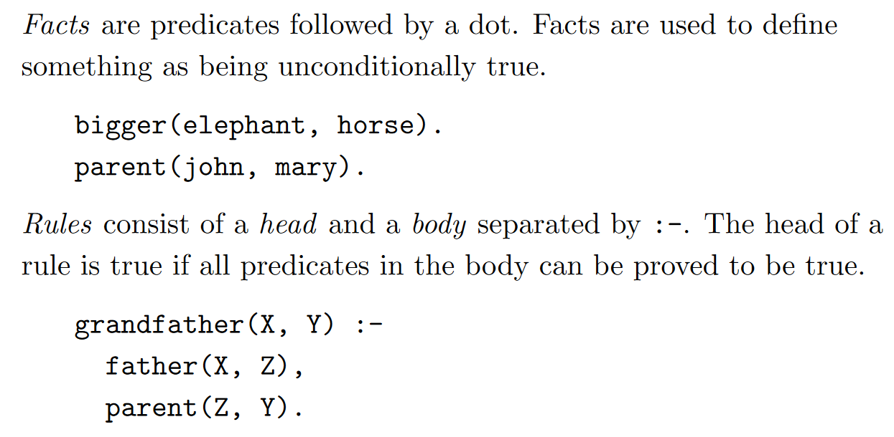
Facts & Rules

Slide 34
Predicate Logic in Prolog
Represents knowledge using predicates, variables, and rules
• Example: bigger(elephant, horse). bigger(horse, donkey).
• Recursive rule captures transitive relationship:
is_bigger(X,Y) :- bigger(X,Z), is_bigger(Z,Y).
Prolog automatically applies logical inference to answer queries:
?- is_bigger(elephant, donkey). → true
Shows First Order Logic (FOL) reasoning in action.

Slide 35
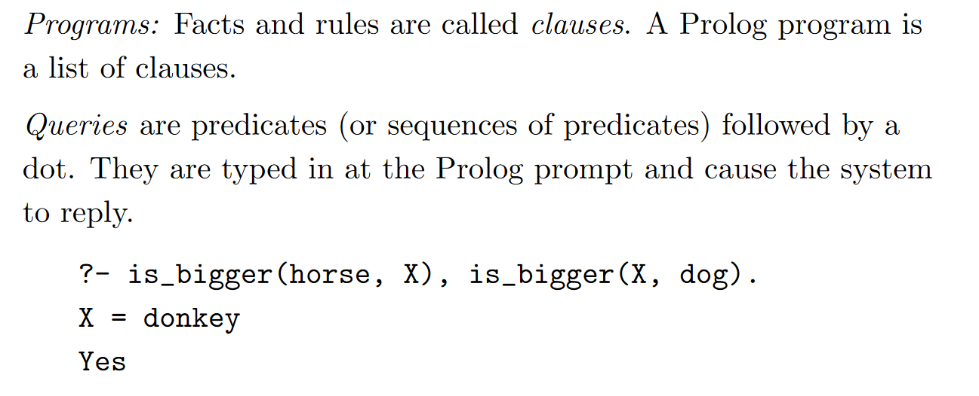
Programs and Queries – Predicate Logic

Slide 36
Forward Chaining
• Data-driven inference: start from facts and trigger rules to derive conclusions
• Example knowledge base:
symptom(flu, fever). symptom(flu, cough). symptom(flu, body_aches).
diagnosis(flu) :- symptom(flu, fever), symptom(flu, cough), symptom(flu, body_aches).
• When all conditions are true, rule fires automatically.
?- diagnosis(flu). → true
Demonstrates how expert systems derive new facts from known ones.

Slide 37
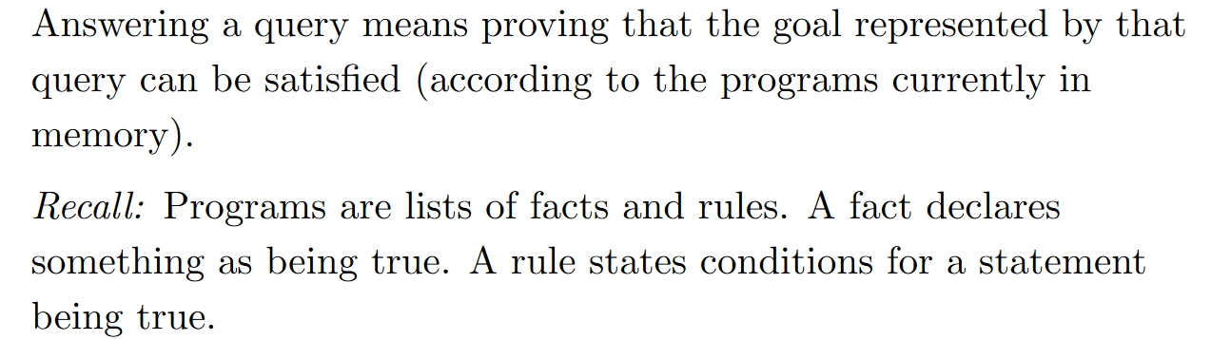
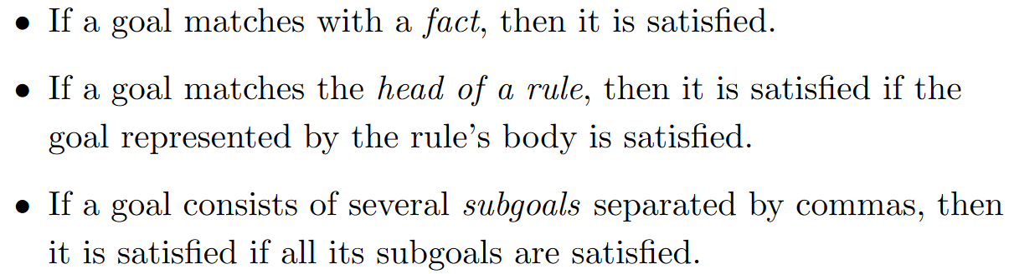
Resolution Theorem
Steps:

Slide 38
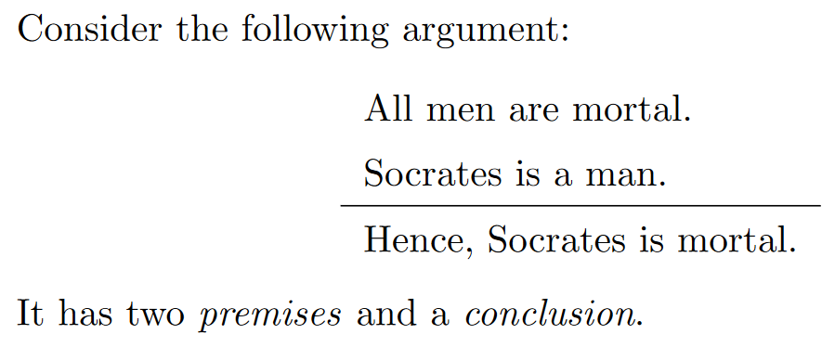
Example: Mortal Philosophers

Slide 39
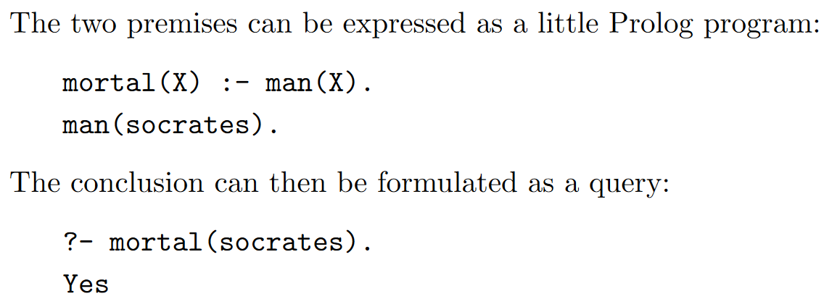
Translating it into Prolog

Slide 40
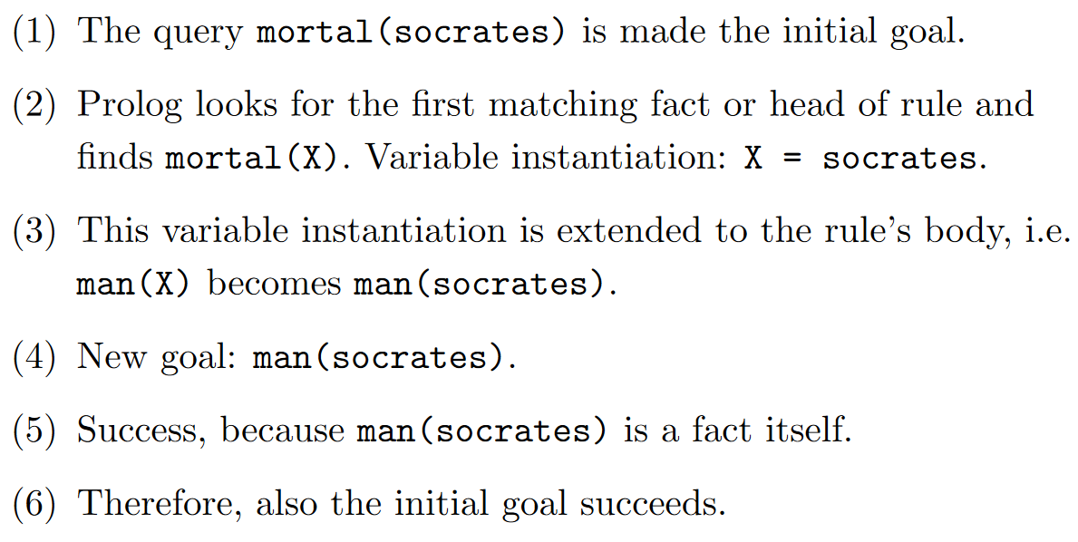
Goal Execution

Slide 41
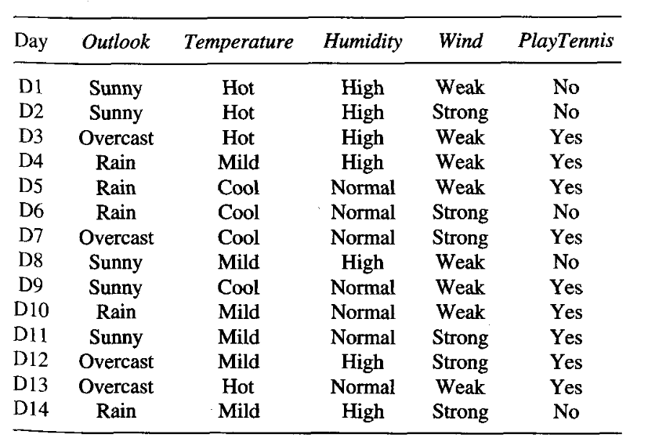
Decision Tree to rules:

Slide 42
